Slide 1
S7 Demo
Jackson Maddox
Johirul Islam
Liangyu Tan

Slide 2
Contents
Array
Formatted print and println
For Loop

Slide 3
Array Definition (Jackson)
Can be defined globally or locally: int arr[<UNSIGNED>];
Access: arr[EXPR()]
Assignment: arr[EXPR()] = EXPR();
Example: array of size 5:
Index: [ 0 , 1, 2, 3, 4, 5]
Value: [ size, ?, ?, ?, ?, ?]
The ‘?’ are 0s for global arrays, garbage values for local arrays.

Slide 4
Array Definition
Global arrays
dw “?\0\0\0“
where ? = (char)size
with size–1 “\0”s
(string is null terminated)
Grows upward (with code)
Size initialized, others to 0
Size limit: 89 (a.exe limitation)
Local arrays
asp –(size+1)
cora (reladdr)
p @size
stav
Grows downward (with stack)
Only size entry initialized

Slide 5
Array Operations
Get index address (local array)
cora (reladdr)
EXPR()
sub
Get index address (global array)
pc (name)
EXPR()
add
Value retrieval (in expr())
(get index address)
load
Value assignment
(get index address)
EXPR()
stav

Slide 6
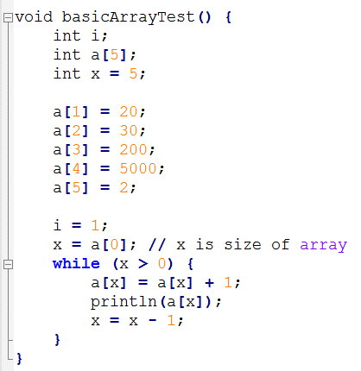
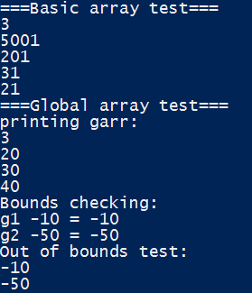
Test results

Slide 7
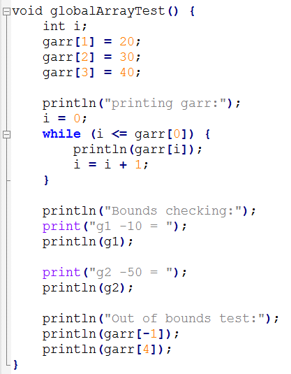

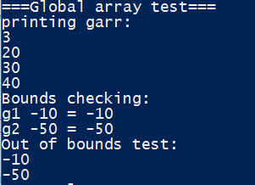
Test results

Slide 8
Formatted print and println (Johirul)
Our S7 supports the formatted print and println statements.
We can use print(“Sum of {0} + {1} = {2}”,5,6,11);
Or we can also use variables print(“Sum of {0} + {1} = {2}.”,x,y,z);

Slide 9
Source Program
An example source program is:
int x = 5;
int y = 6;
int z;
void main()
{
t();
}
void t()
{
z =x*y;
print("Product of {0} * {1} = {2}. Bye.",x,y,z);
}

Slide 10
Generated output code related to print
pc @LL12
sout
^@LL12: dw "Product of "
p x
dout
pc @LL18
sout

Slide 11
^@LL18: dw " * "
p y
dout
pc @LL24
sout
^@LL24: dw " = "
p z
dout
pc @L0
sout
^@L0: dw ". Bye."

Slide 12
We can also pass the numbers directly
void main()
{
t();
}
void t()
{
z =x*y;
print("Product of {0} * {1} = {2}. Bye.",5,6,30);
}

Slide 13
The generated Assembly code here is
pc @L0
sout
^@L0: dw "Product of 5 * 6 = 30. Bye."

Slide 14
Technique used (Pseudocode)
When I face a COMMA instead of RIGHTPAREN I lookahead create a list of either variables or constants.
Then I generate Labels for each variable
The I split the String in into different parts at the positions of formatting.
Each part is displayed with a separate sout command.
And in between separate sout command dout command prints the variable from the list at the corresponding index using dout.

Slide 15
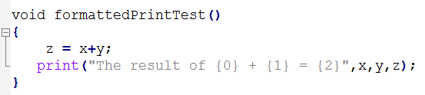

Test results

Slide 16
For Loop (Liangyu)
Form:
for( int i = 0; i < k; i = i +1)
{
// statements
}

Slide 17
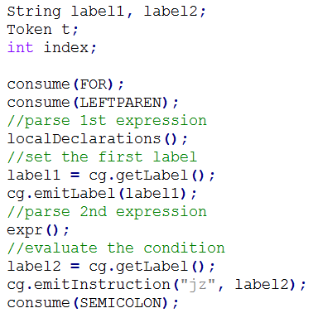
For Loop
Structure of the assembly code:
{
initialization (int i = 0;)
set label 1
evaluate the expression (i < k;)
update the value of i
implement statements
set label 2
}

Slide 18
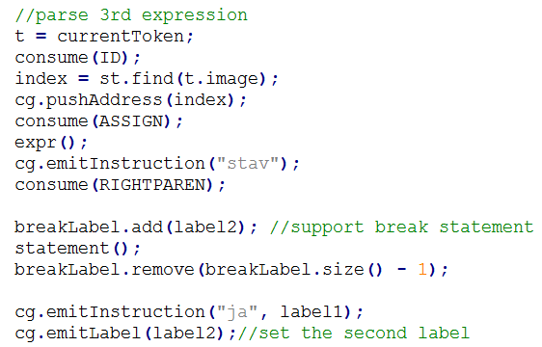
For Loop
Structure of the assembly code:
{
initialization (int i = 0;)
set label 1
evaluate the expression (i < k;)
update the value of i
implement statements
set label 2
}

Slide 19
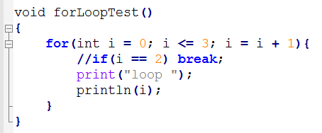

Test results

Slide 20
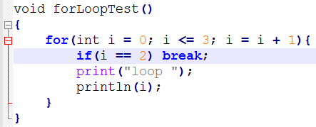

Test results

Slide 21
Thank you!

